Slide 1
Advanced LLRF Automation and Diagnostic Strategies for Horizontal Testing of HIAF SRF Cavities
The Low Level Radio Frequency Workshop 2025 (LLRF2025)
Feng QIU, Yuan HE, Lijuan YANG, Zheng GAO, Jiayi PENG, Tiancai JIANG (IMP)
Rihua ZENG (Dongjiang Lab)

Slide 2


01
Introduction
02
RF Parameter Characterization
CONTENTS
03
Automation, Diagostic & Opt.
04
Summary

Slide 3
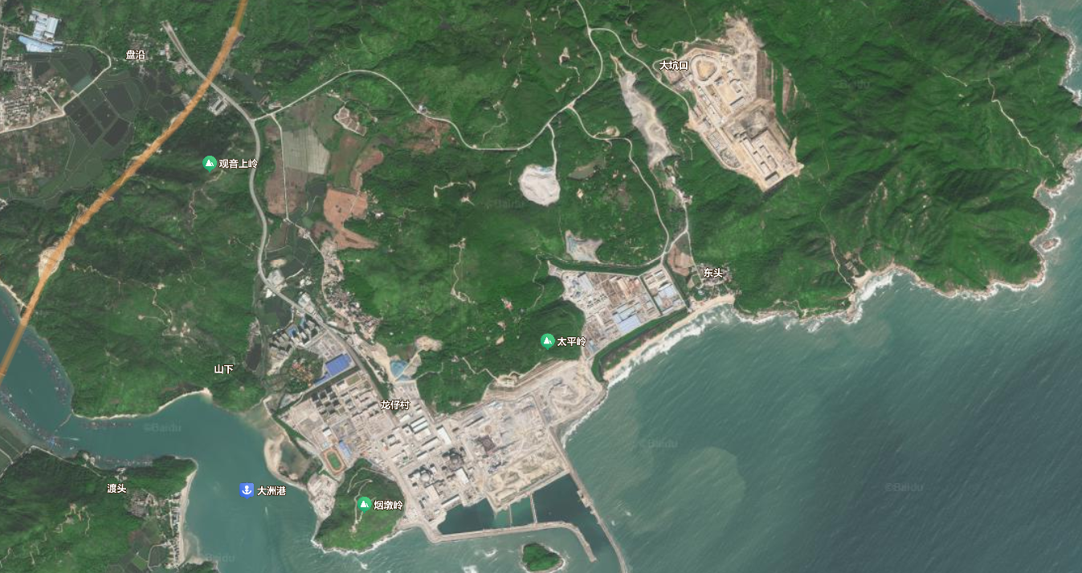
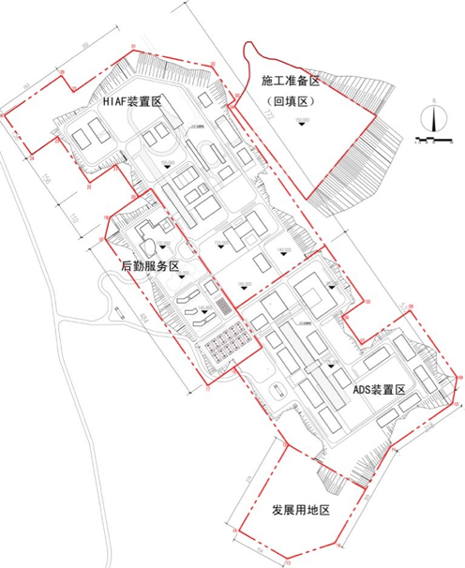
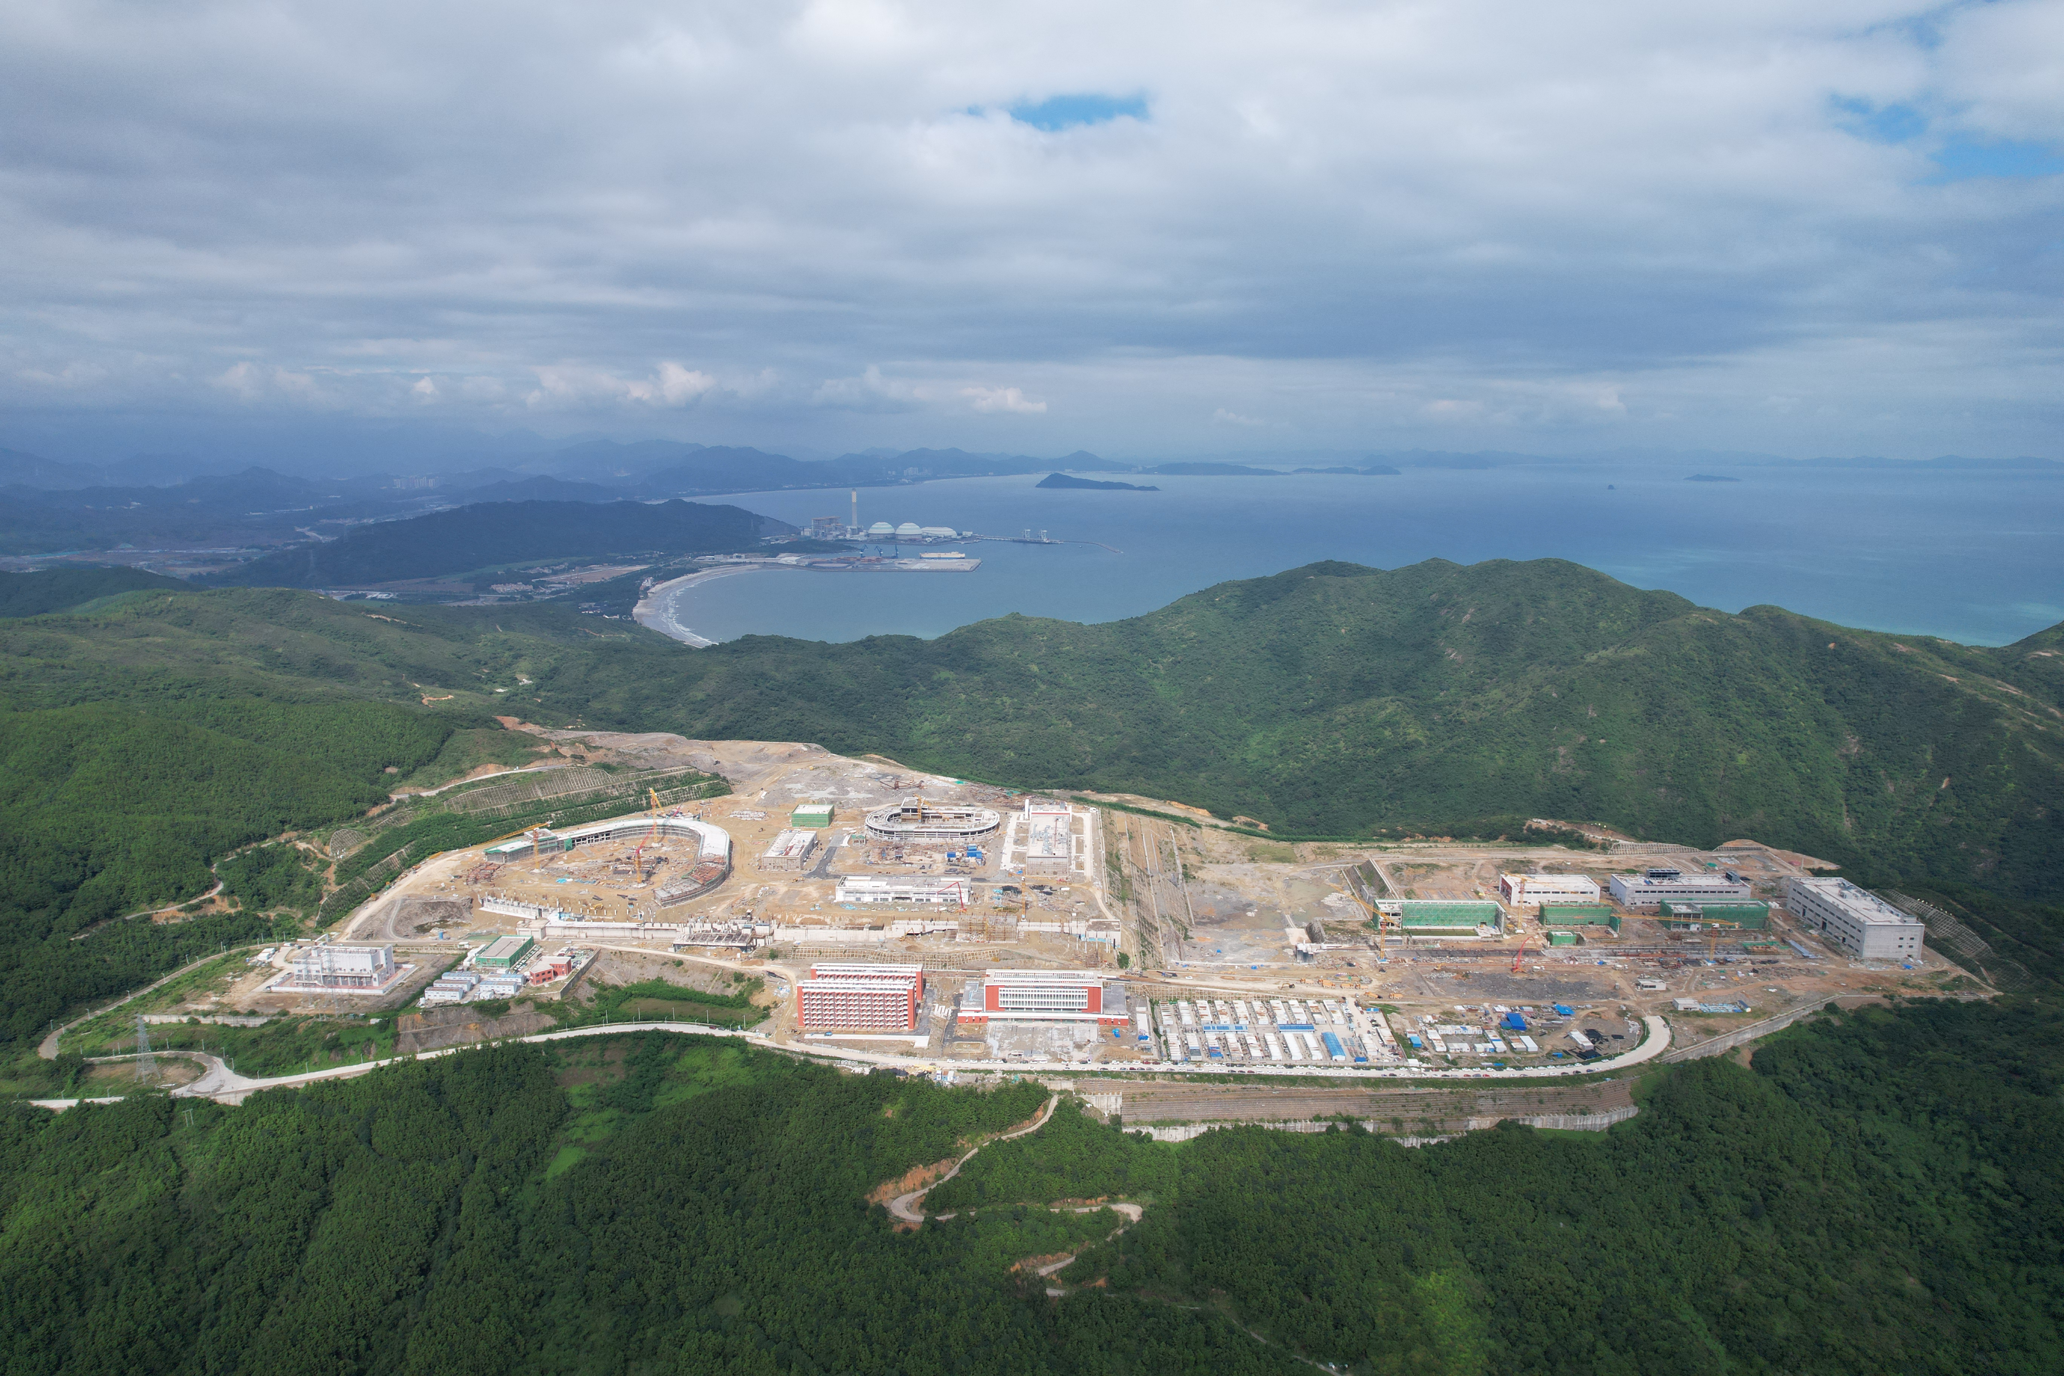
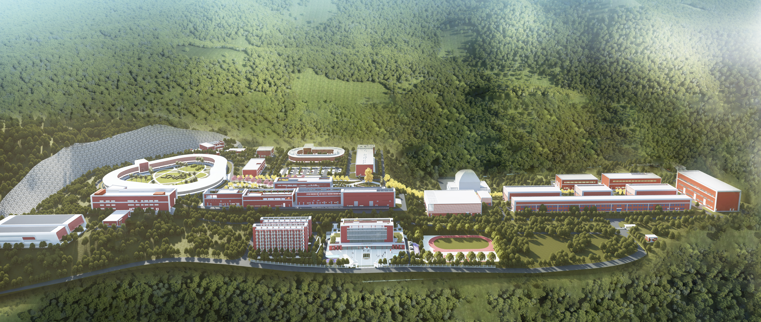
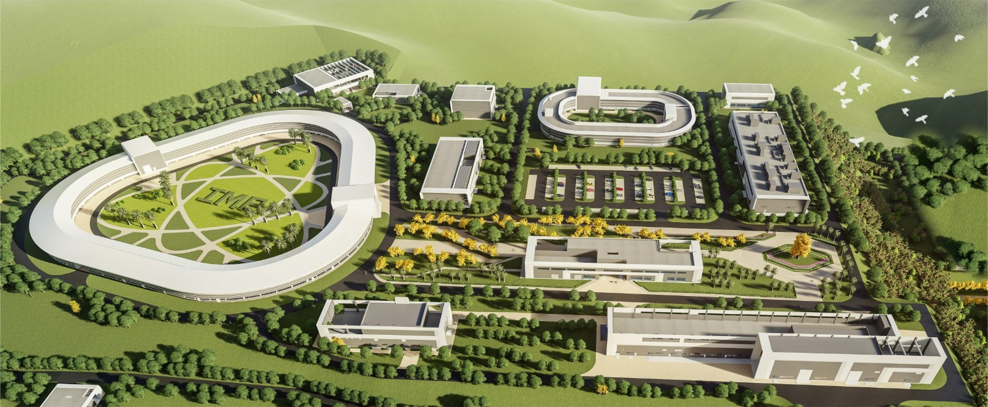
Introduction
Two new large-scale facilities were built in Hiuzhou, Guang Dong Province
HIAF: High Intensity heavy-ion Accelerator Facility
CiADS: China Initiative Accelerator Driven System
IMP (Lan zhou)
HIAF and CiADS
2 km
CiADS&HIAF (Hui zhou)
Taipingling Nuclear Power Plant
Architectural Rendering
iLINAC
Aerial View
HIAF (High Intensity heavy-ion Accl. Facility)

Slide 4
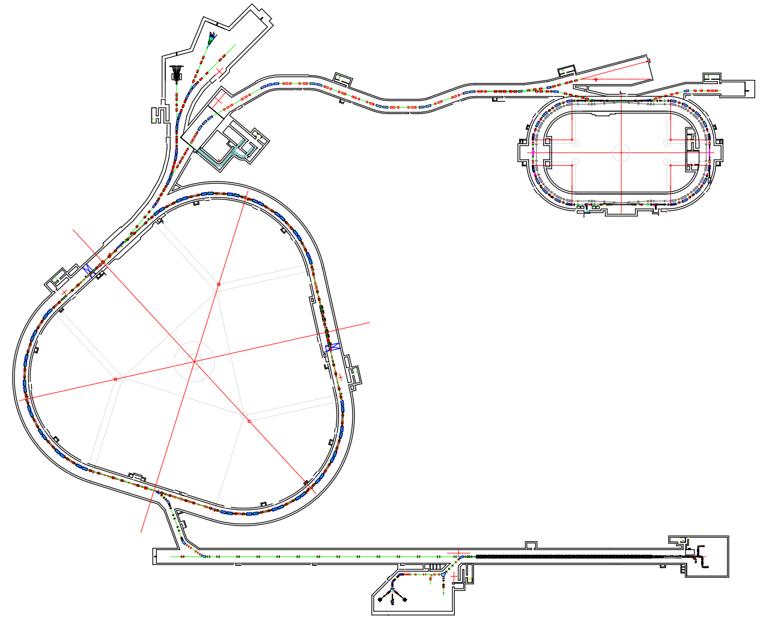
HIAF Facility
Motivation and facility layout
Hyper nuclear Research Facility
Properties of Nuclear Matter
High-Energy Irradiation - Single Particle
Project Engineering Objectives
Expanding the Landscape of New Nuclides
Weakly Bound Nuclear Structure and Reaction Mechanisms
Precise Measurement of Nuclear Masses
T4
T2
External Target Terminal
HFRS
T6
High-Energy Density Terminal
T3
SRing
Radioactive Beam Line
T5
BRing
High-Precision Toroidal Spectrometer
Electron-Ion Recombination Spectrometer
Ions targets：
5-250 MeV/u CW heavy ions beam
35 MeV/u-5.7GeV/u pulse beam
iLinac
SECR
T1
Isotope Terminal

Slide 5
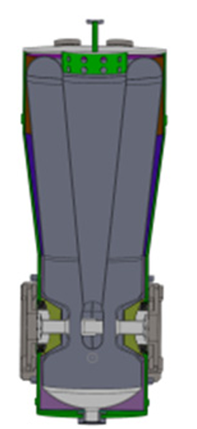
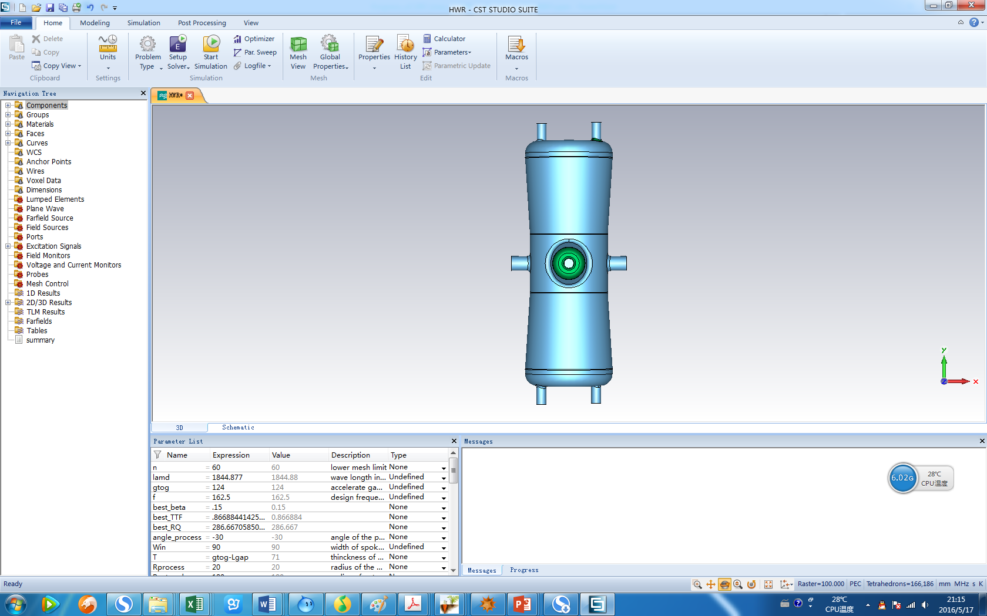
HIAF-iLINAC
iLINAC layout and parameters
iLinac Design Specification：Continuous wave (CW) and pulsed beam
Component Structure : Room temperature front end and Superconduct linac
0.8MeV/u
β =0.04
β =0.19
SSA
...
...
SECR
LEBT
RFQ
MEBT
QWR007
HWR015
17MeV/u
(²³⁸U³⁵⁺)
ions | Q/A | intensity | Energy (MeV/u) | Operation mode
²³⁸U³⁵⁺ | 1/7 | 1.0 emA | 17 | Pulse
⁷⁸Kr¹⁹⁺ | 1/4.1 | 1.0 emA | 27
¹⁸O⁶⁺ | 1/3 | 1.0 emA | 33
H₂⁺ | 1/2 | 0.6 emA | 48
48Ca-70Zn | - | 10 pμA | 4-8 | CW
Xe-U | - | 10 pμA | 5-22
β = 0.076
f = 81.25 MHz
β = 0.15
f = 162.5 MHz

Slide 6
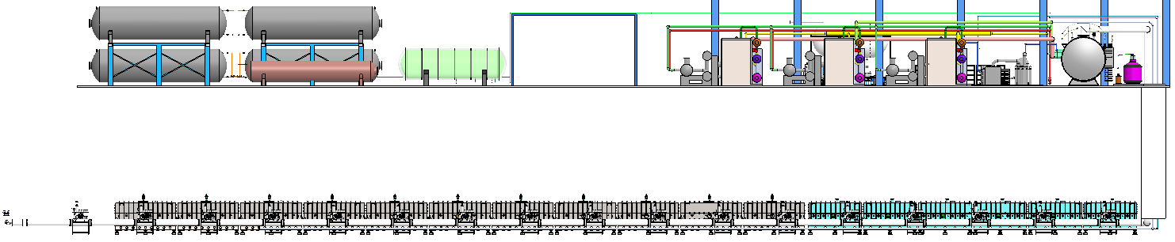
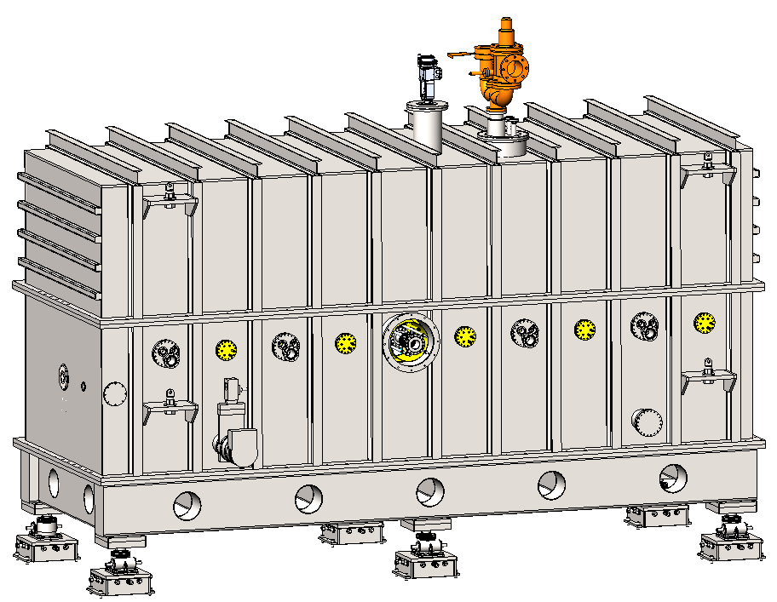
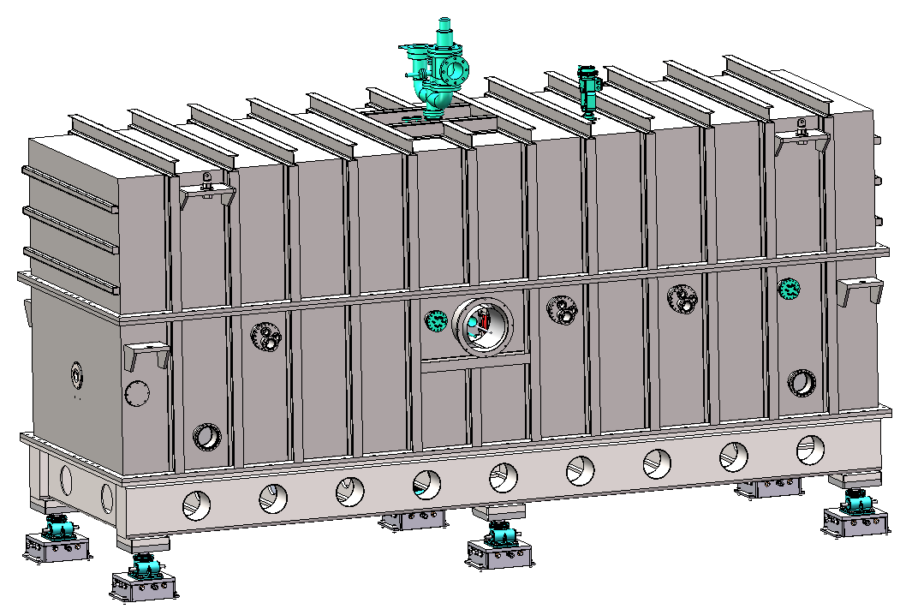
SRF Cavities
HIAF SRF linac employs 17 cryomodules with 96 SRF cavities
Cold box
Helium gas storage station
QWR007 (x6): 30 cavs
HWR015 (x11): 66 cavs.
QWR007
HWR015
~100 m
SECR
LEBT
RFQ
MEBT
0.8MeV/u
5.3MeV/u
17MeV/u
 | QWR007 | HWR015
CM Quantity | 6 | 11
CM Length [mm] | 5073 | 5836
CM Width [mm] | 2000 | 2000
CM Height [mm] | 3800 | 3800
Cavity Quantity | 5 | 6
Solenoid Quantity | 5 | 2
BPM Quantity | 4 | 1
SOL
QWR
SOL
QWR
SOL
QWR
SOL
QWR
SOL
QWR
CM-QWR007 (x6)
SOL
HWR
HWR
HWR
SOL
HWR
HWR
HWR
CM-HWR015 (x11)

Slide 7
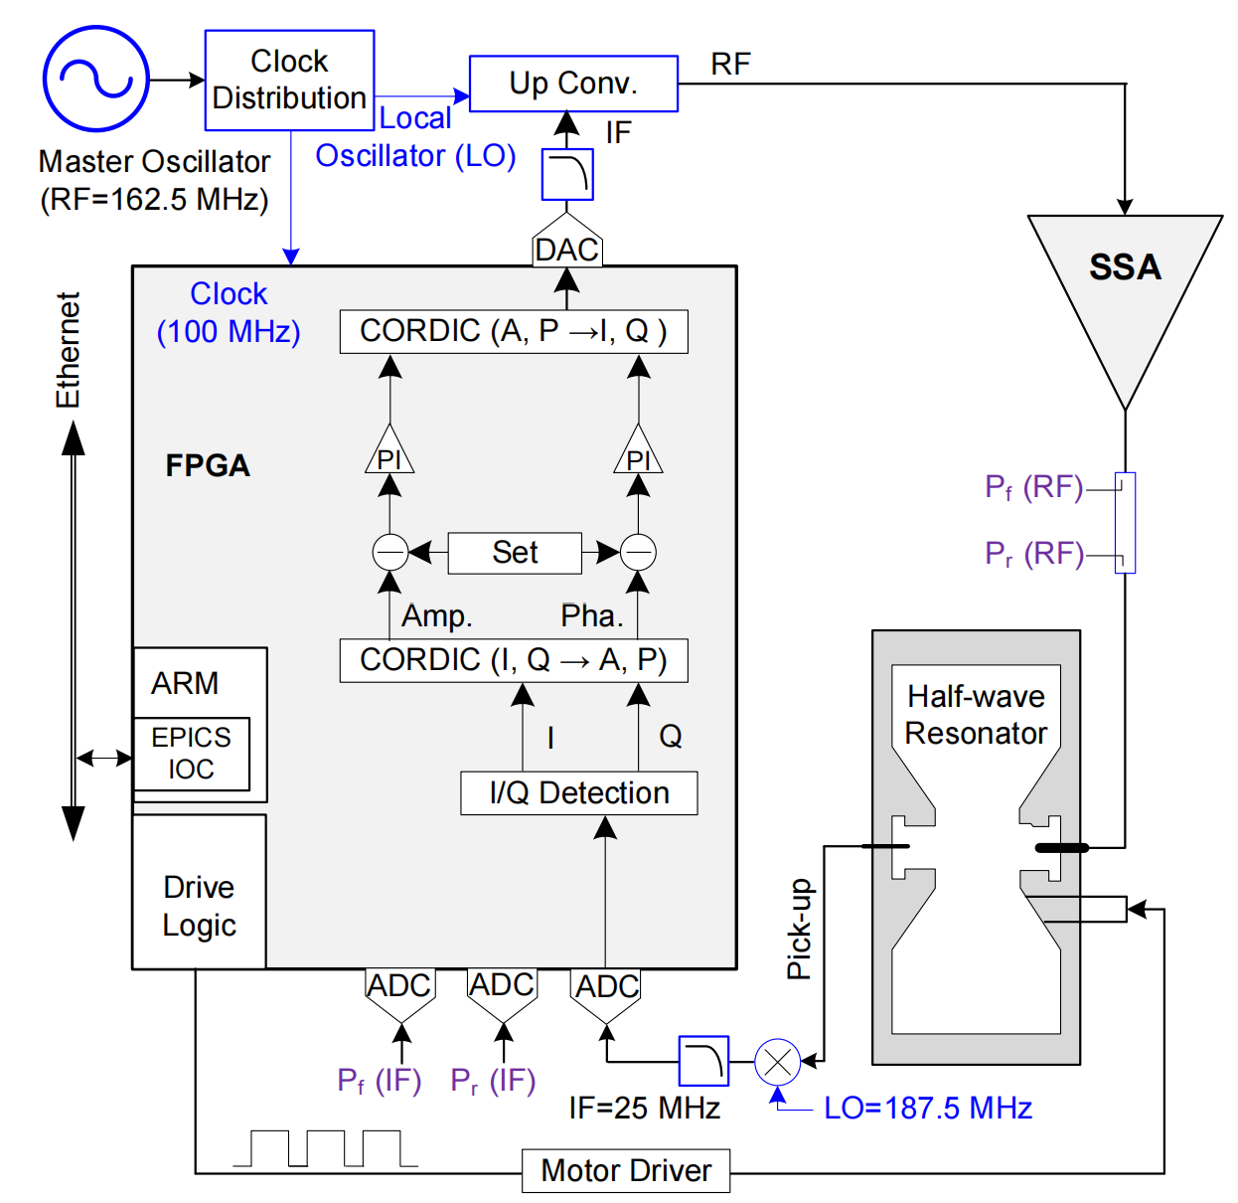
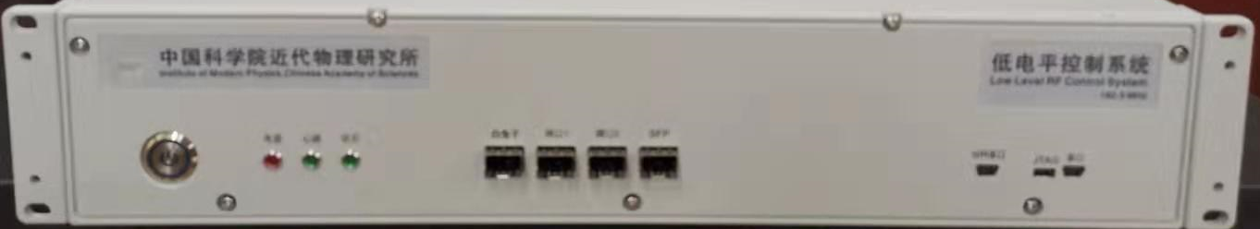
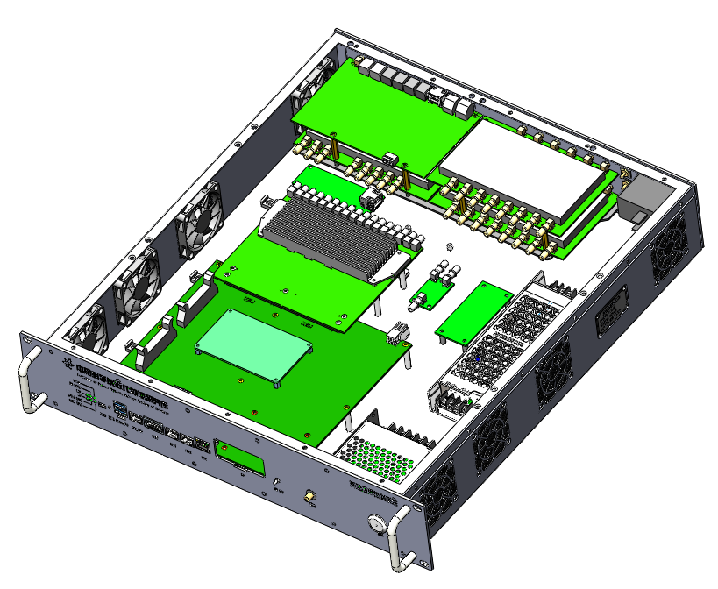
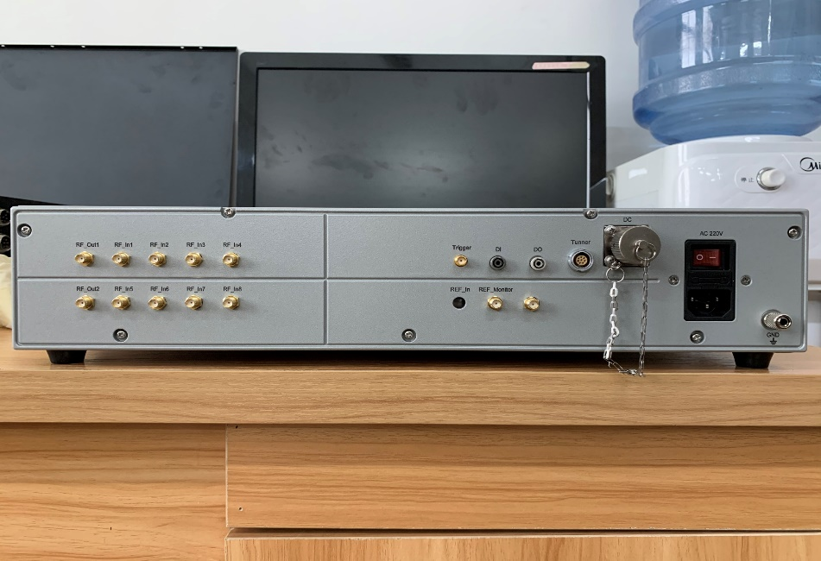
Low Level RF
Hardware:
ADC (×8): ADS42Ib69, 16-bits, 250 MHz
DAC (×2): AD9747, 16-bits, 250 MHz
FPGA: XCZU19EG
ARM: 19eg
Motor Tuner
Algorithm:
A/P ctrl.
Individual ctrl.

Slide 8


01
Introduction
02
RF Parameter Characterization
CONTENTS
03
Automation, Diagostic & Opt.
04
Summary

Slide 9
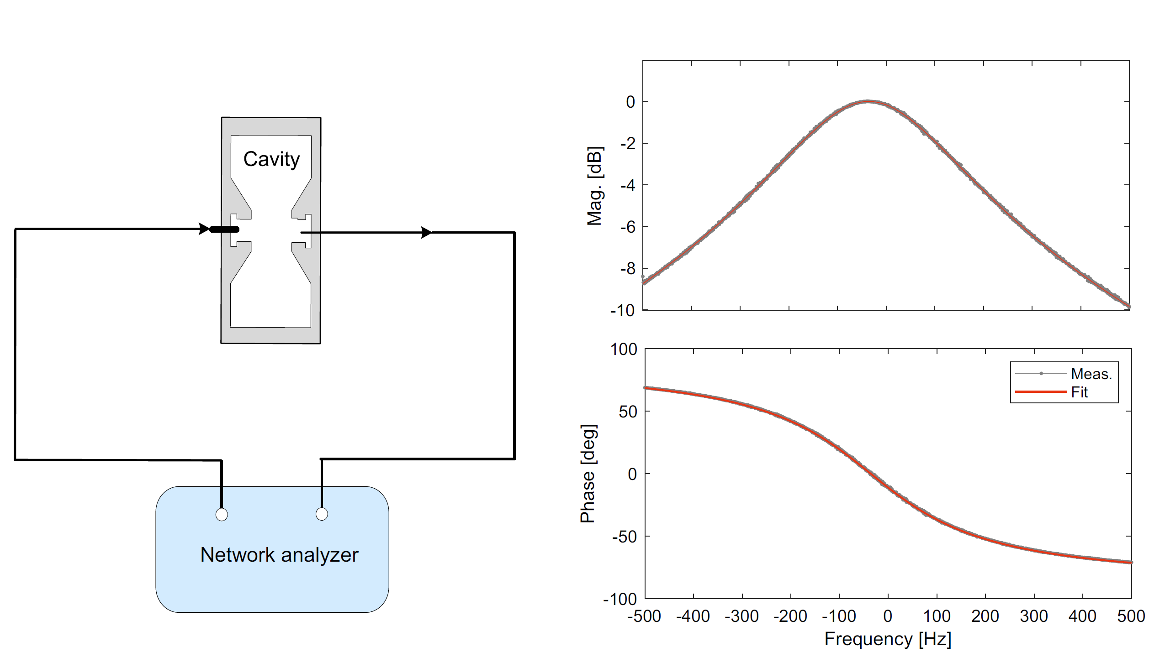
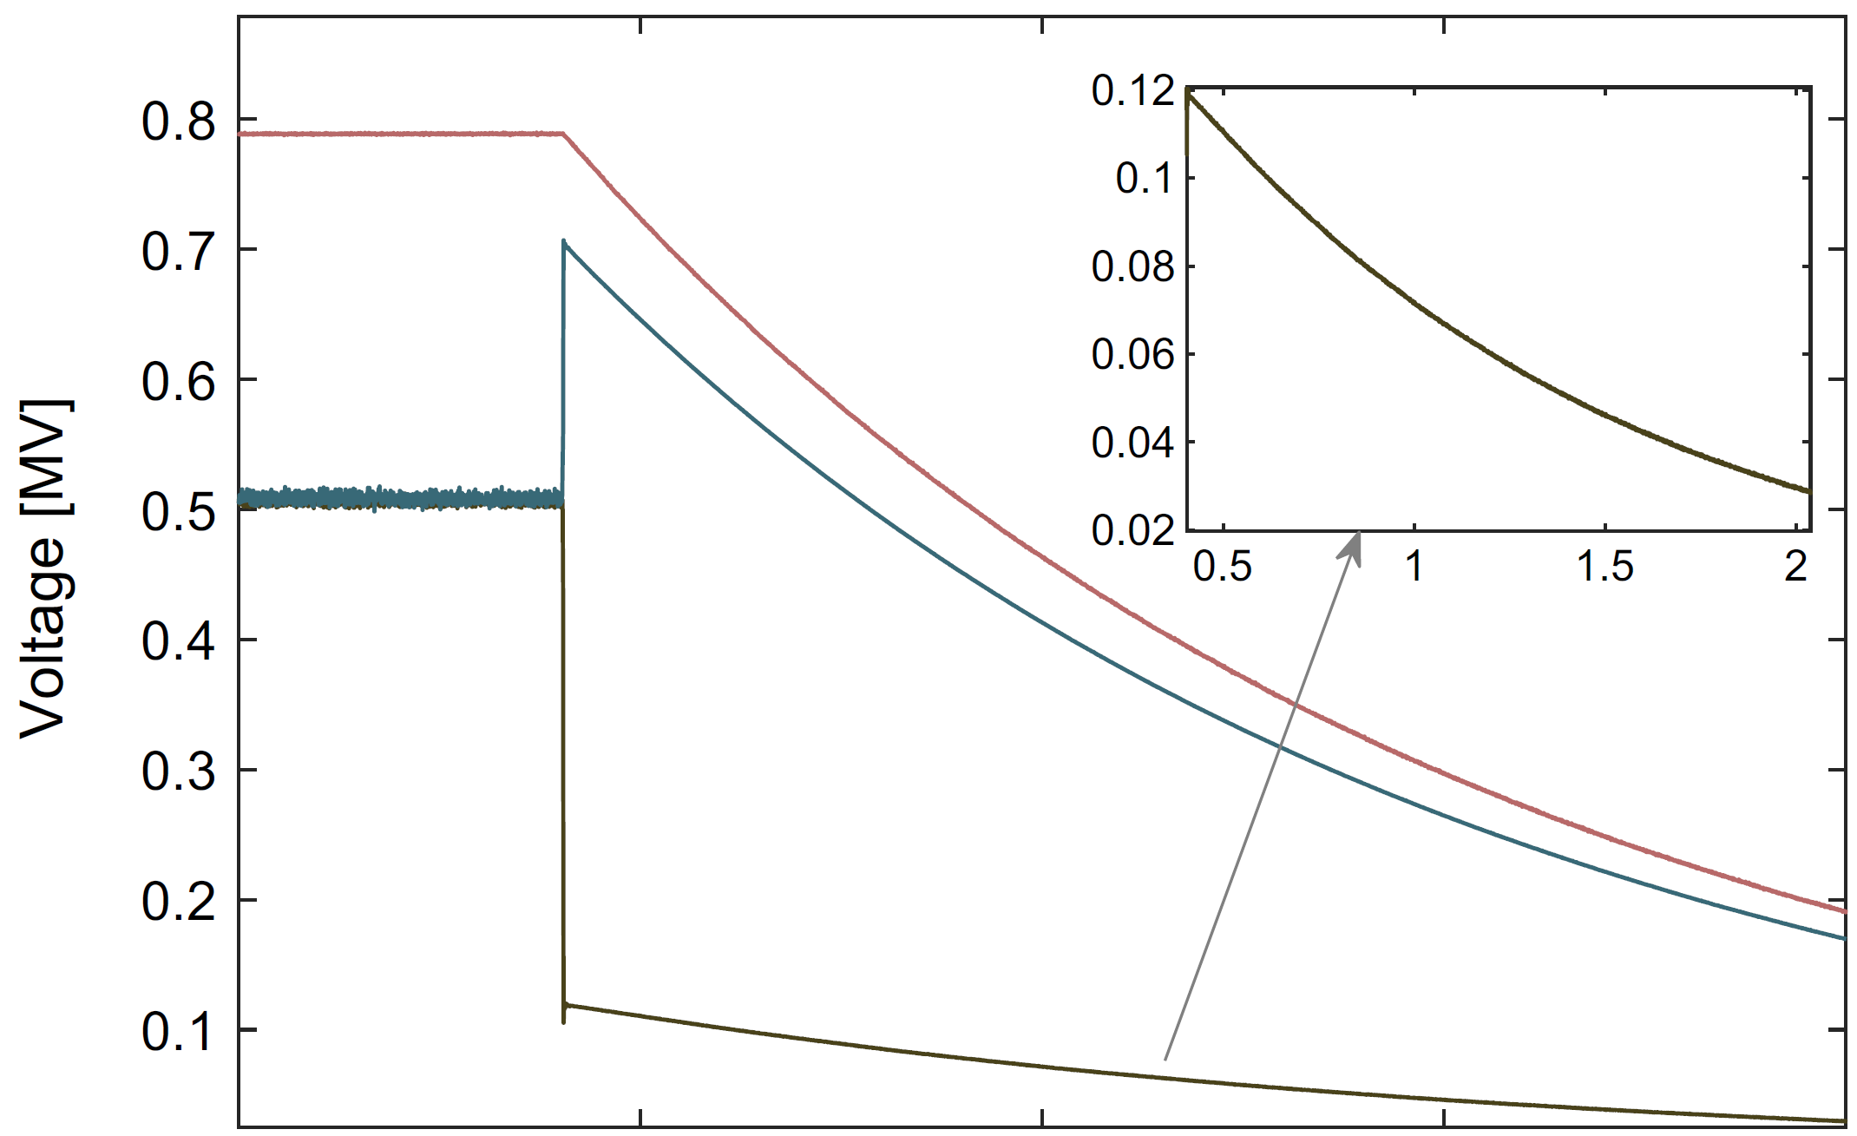
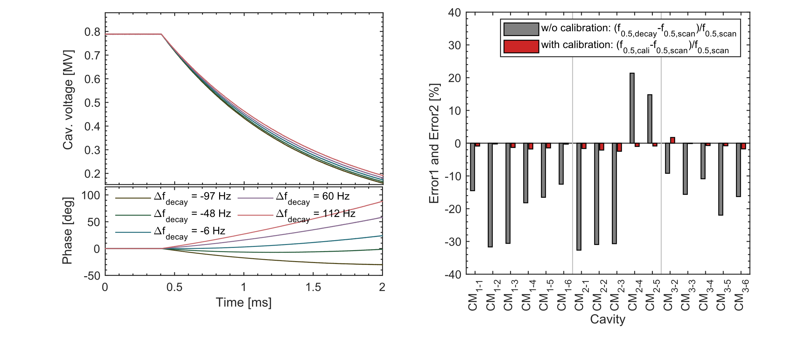
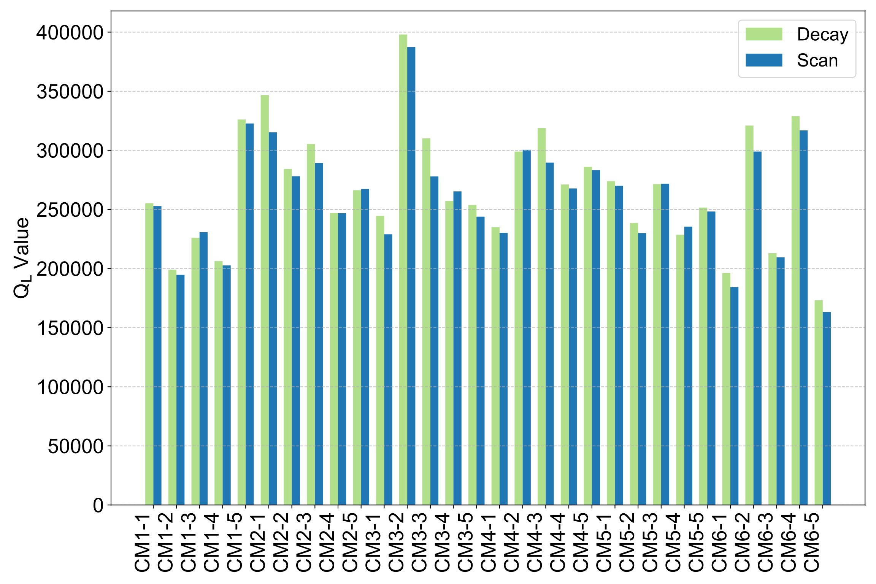

Measurement of Q_{L}
Calibration of QL under impedance mismatch
Error ↓ from ±30 % to ±2 %
Consistent with network-analyzer scan
The residual V_{f} after RF off
3dB half-bandwidth (f_{0.5,scan})
Imp. mismatch
Field decay
RF off
Before cali：Err~±30%
After cali.：Err~±2%
Detuning-dependent
Scan
Decay
J. Y. Ma,… F. Qiu* et al., Measurement of the cavity‑loaded Q factor in SRF systems with mismatched source impedance, Nucl. Sci. and Tech. 34:12, 2023
J. Y. Ma,… F. Qiu* et al., Application of a new cavity-loaded factor calibration algorithm on the Test Stand 2 facility at the European, Radiation Detection Technology and Methods, 8:4, 2024

Slide 10
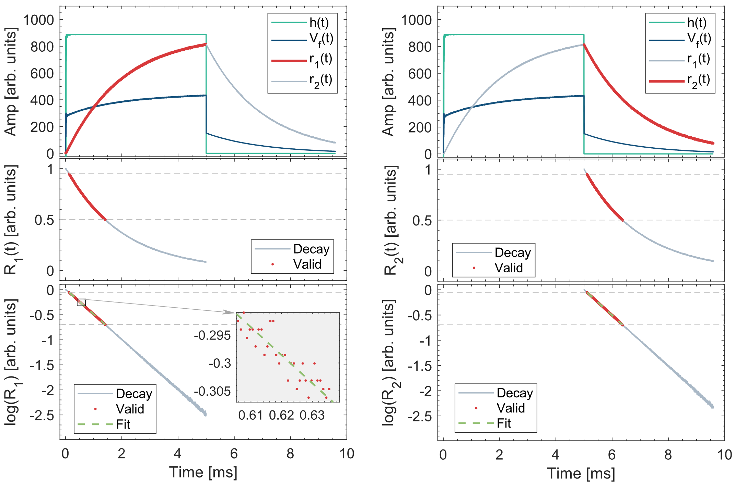
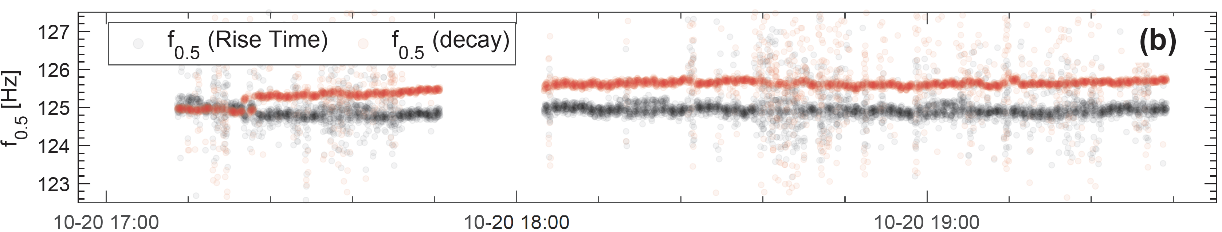
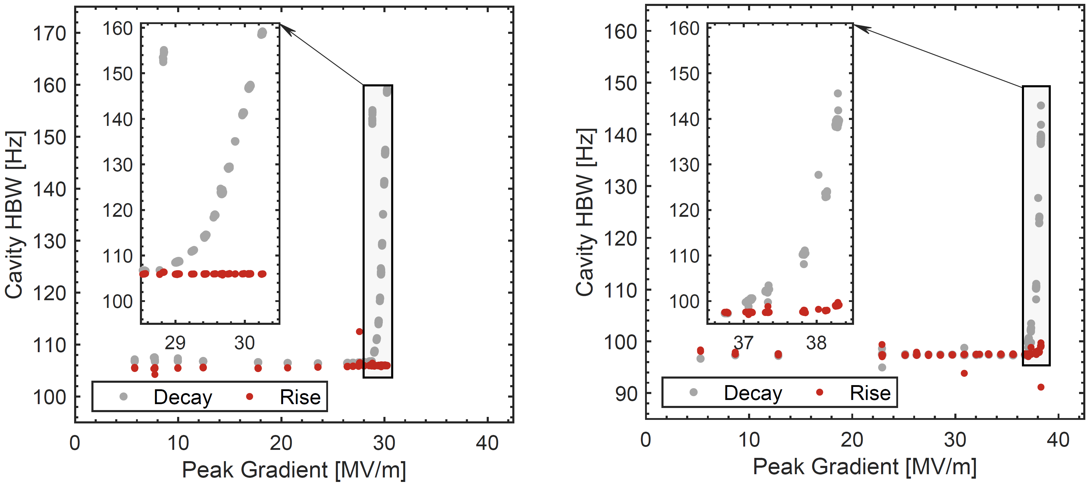
Measurement of Q_{L} (cont’d)
Rise and decay-based Q_{L} measurement agree well
During quench, decay-based Q_{L} drops rapidly (f_{0.5} ↑), while rise-based remains stable → providing a possibility for quench detection
Rise-based
Decay-based
Decay-based
Rise-based
Decay-based
Rise-based
Quench onset field

Slide 11
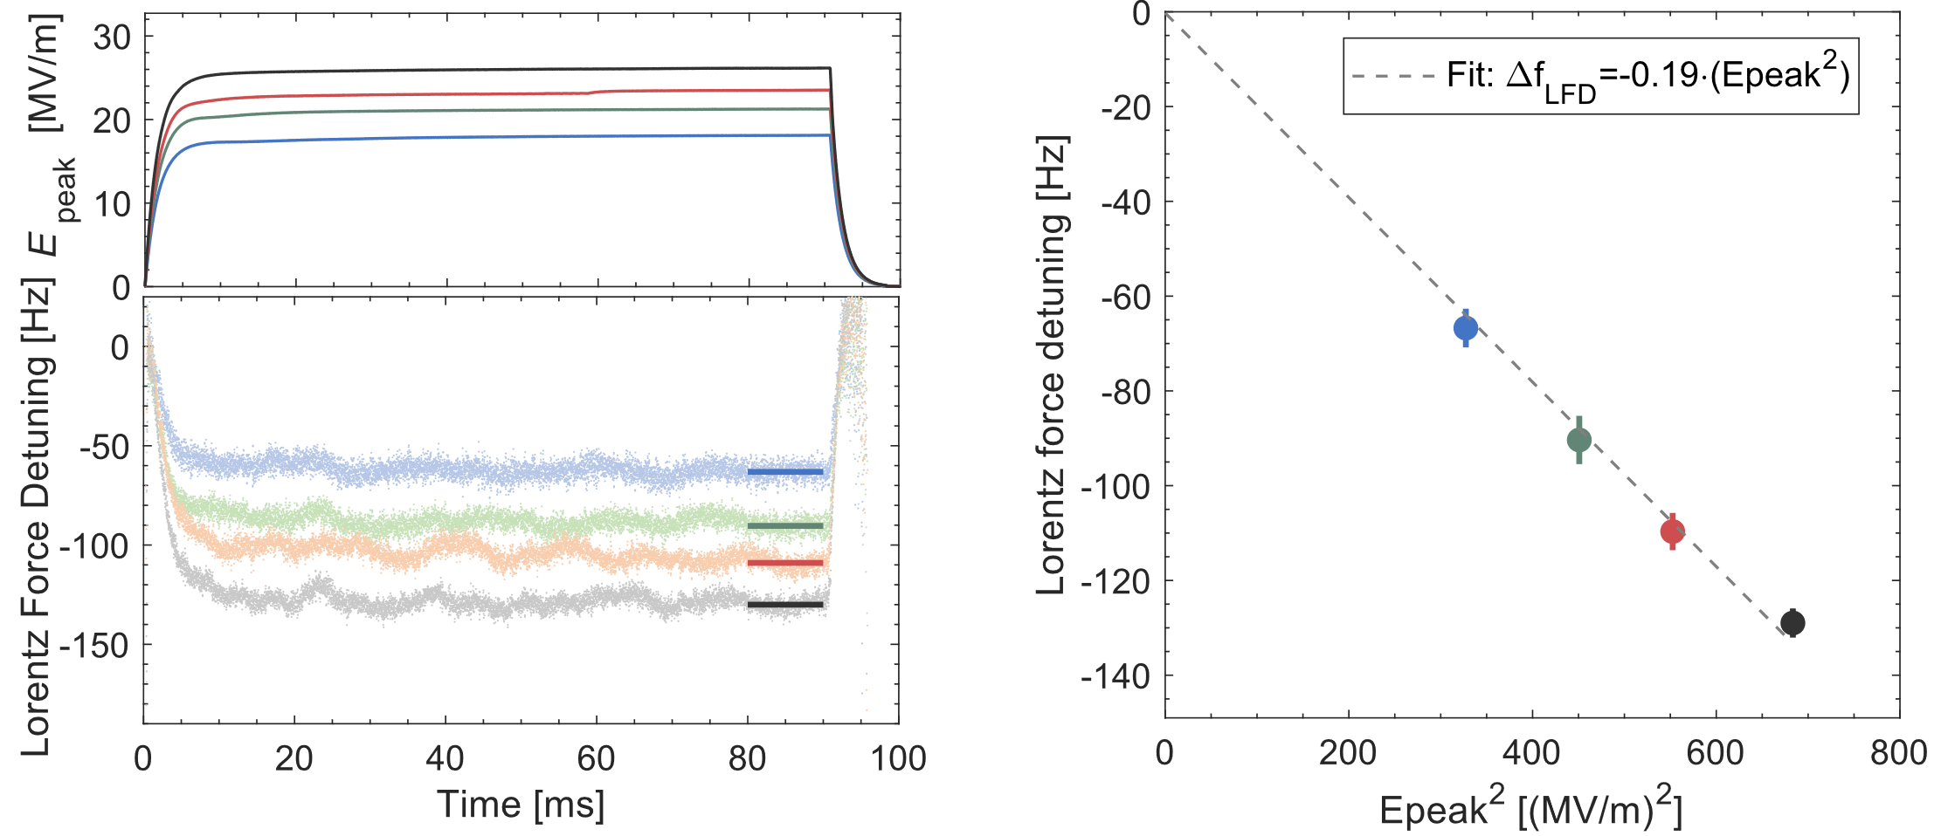
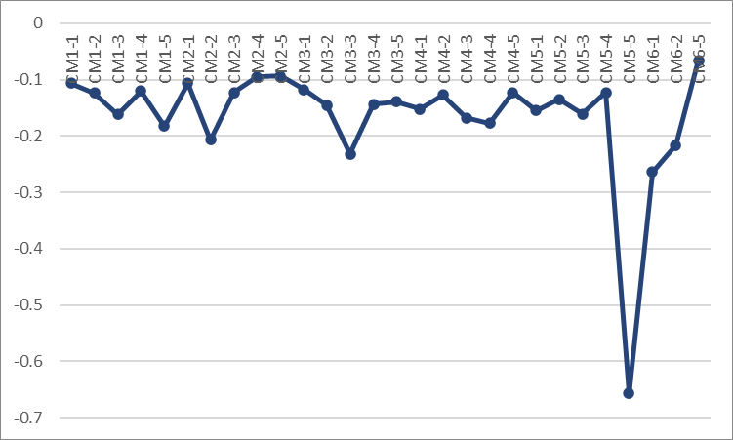
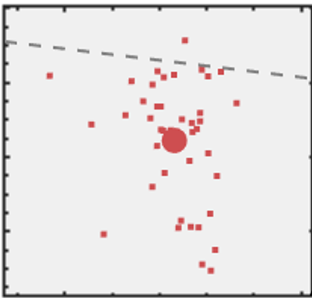
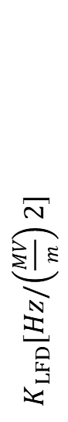
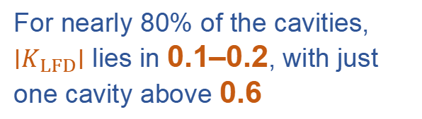
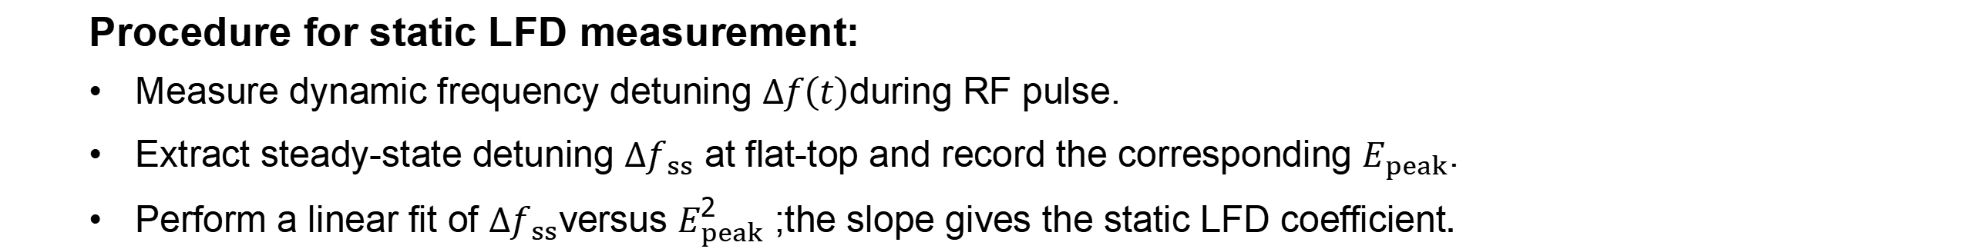
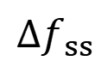
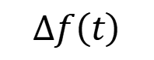
Static LFD coefficients
Procedure for static LFD measurement:
Measure dynamic frequency detuning $Δf\left(t\right)$during RF pulse.
Extract steady-state detuning $Δf_{ss}$ at flat-top and record the corresponding $E_{peak}$.
Perform a linear fit of $Δf_{ss}$versus $E_{peak}^{2}$; the slope gives the static LFD coefficient.
For nearly 80% of the cavities, $∣K_{LFD}∣$ lies in 0.1–0.2, with just one cavity above 0.6
$K_{LFD}[Hz/\left(\frac{MV}{m}\right)2]$
$$Δf\left(t\right)$$
$Δf_{ss}$
-0.66
A. Bellandi et al., IEEE Transactions on Nuclear Science, vol. 68, no. 4, pp. 385-393

Slide 12
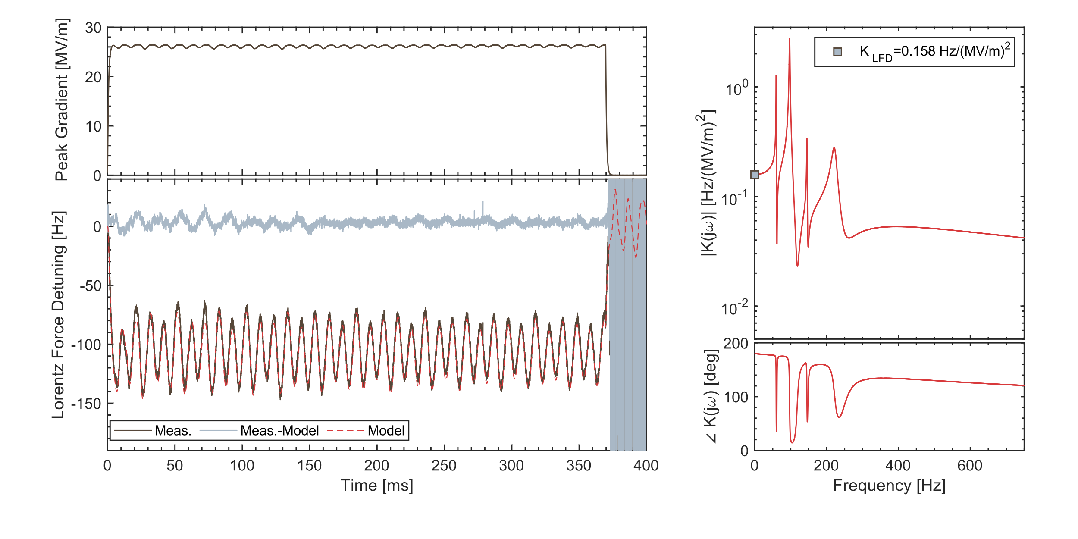
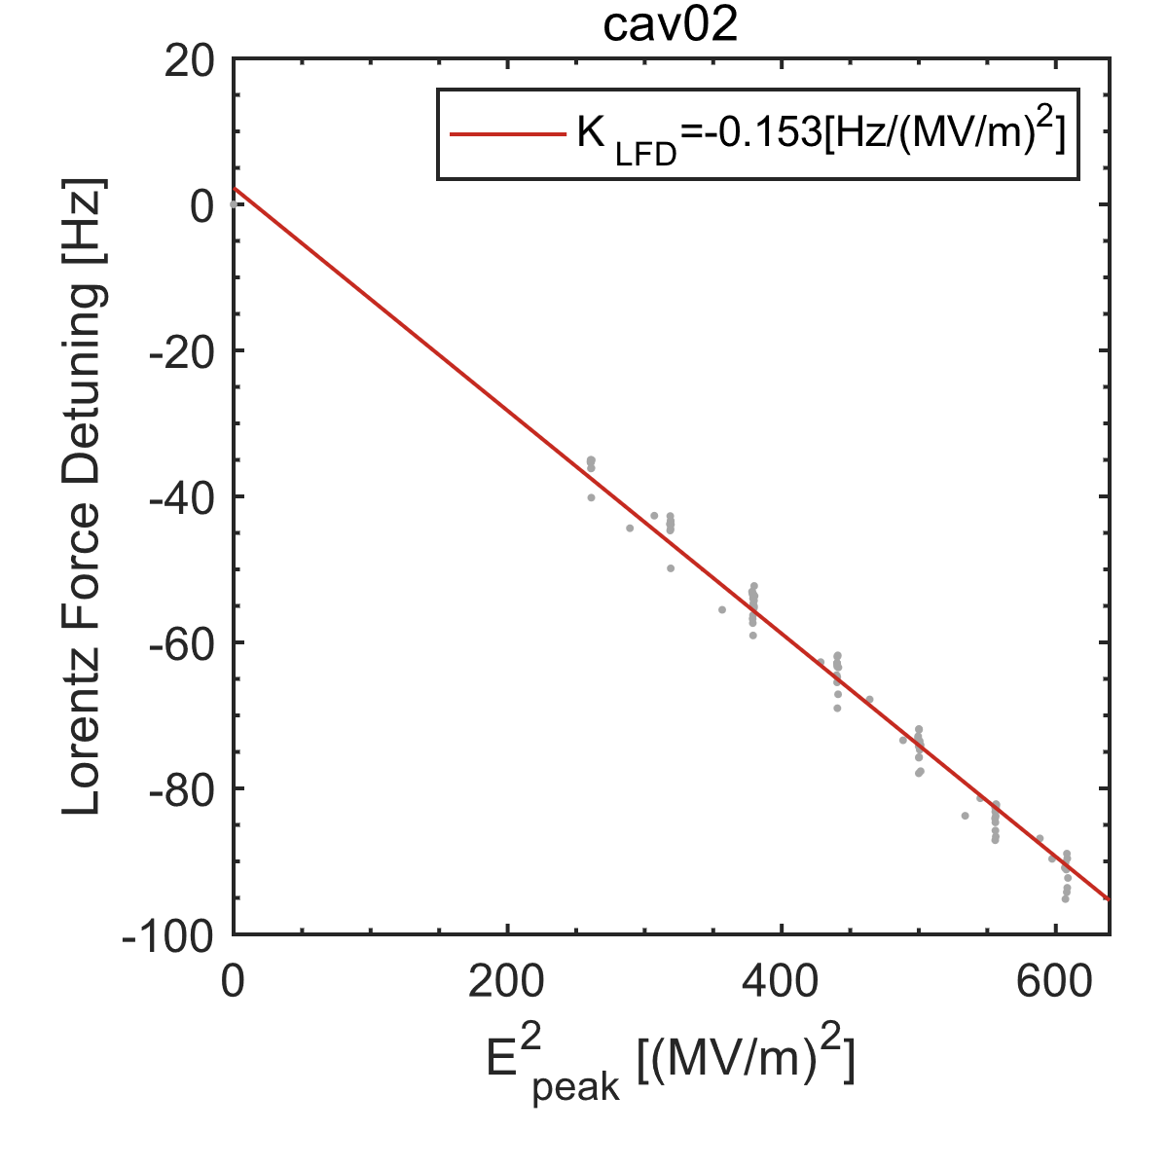
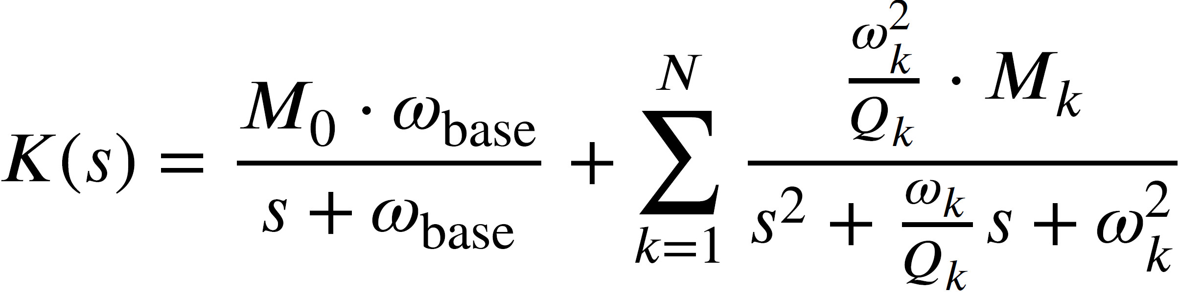
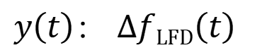
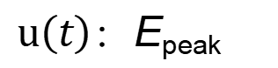
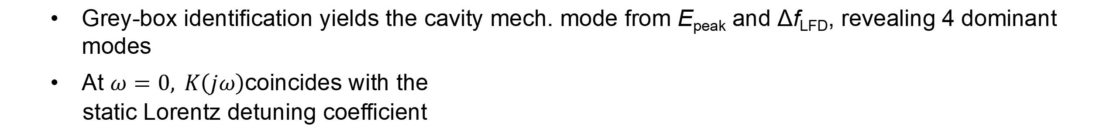
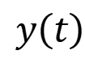
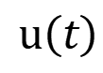
Dynamic LFD Model
Grey-box identification yields the cavity mech. mode from E_{peak} and Δf_{LFD}, revealing 4 dominant modes
$\text{At} ω=0, K\left(jω\right)$coincides with the
static Lorentz detuning coefficient
$$u\left(t\right)$$
$$y\left(t\right)$$
Grey-box Model
greyest
Static LFD coefficient
$u\left(t\right)$：E_{peak}
LFD Model
K_{LFD}
$y\left(t\right)$： $ΔfLFD\left(t\right)$
K_{LFD}
F. Qiu*, Z. L. Zhu, J. Y. Ma et al., An approach to characterize Lorentz force transfer function for superconducting cavities，Nucl. Instrum. Methods Phys. Res. A 1012 (2021) 165633
Notes:
By applying grey-box system identification using $E_{\text{peak}}$and the measured Lorentz-force detuning, the transfer function of the cavity mechanical modes can be obtained, allowing estimation of the dominant modes.
The low-frequency limit of the identified mechanical transfer function $K\left(jω\right)$($ω→0$) agrees well with the static Lorentz-force detuning coefficient.

Slide 13
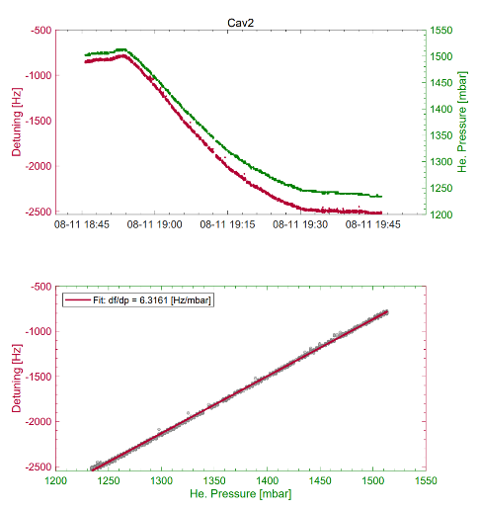
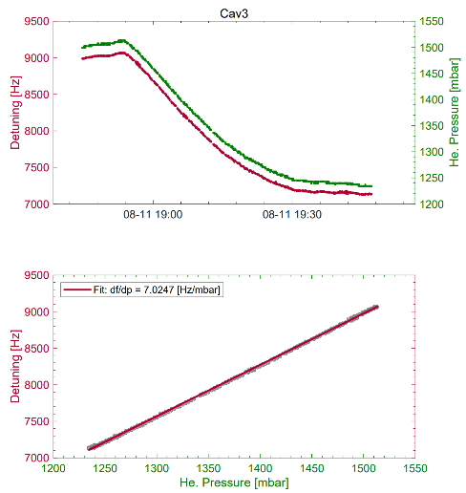
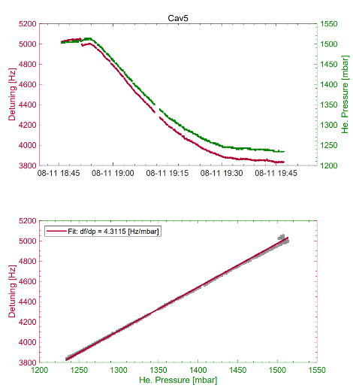
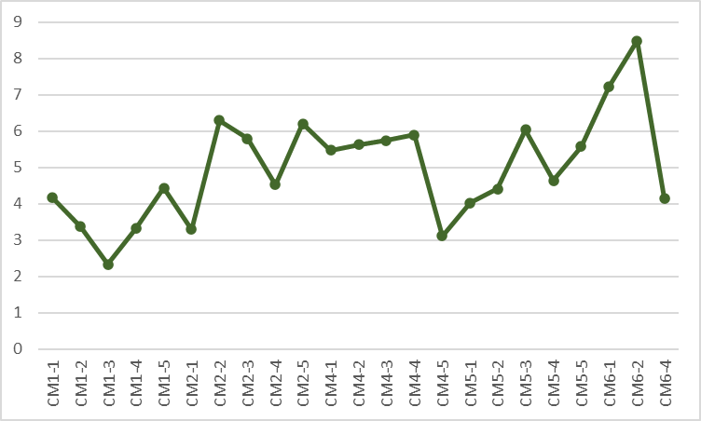
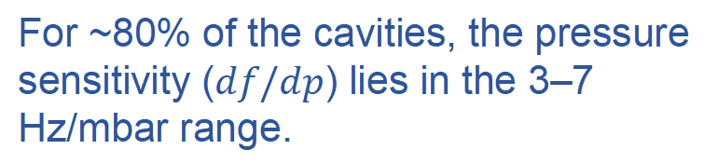
Pressure sensitivity
Cavity pressure sensitivity coefficient (df/dp) is determined from helium-pressure induced detuning, with detuning extracted from the decay-phase slope of RF pulses
For ~80% of the cavities, the pressure sensitivity ($df/dp$) lies in the 3–7 Hz/mbar range.

Slide 14
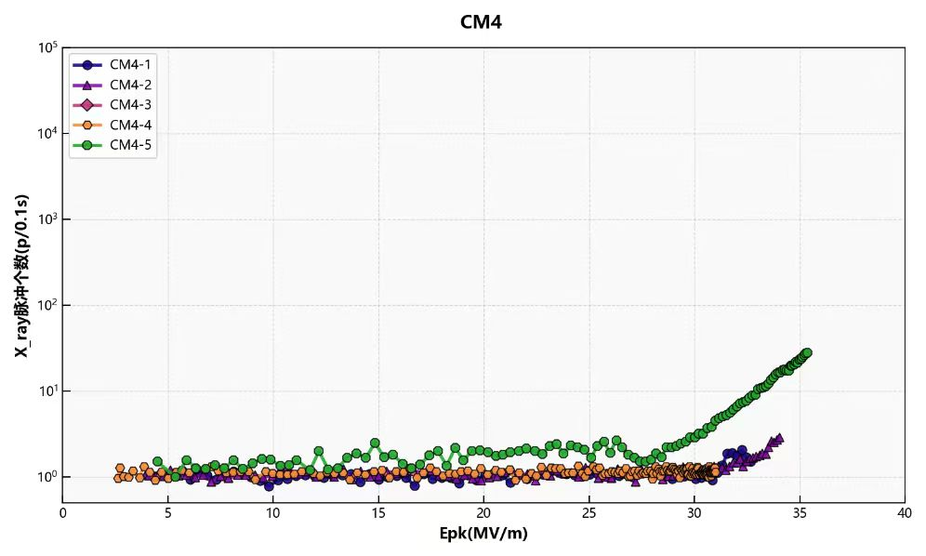
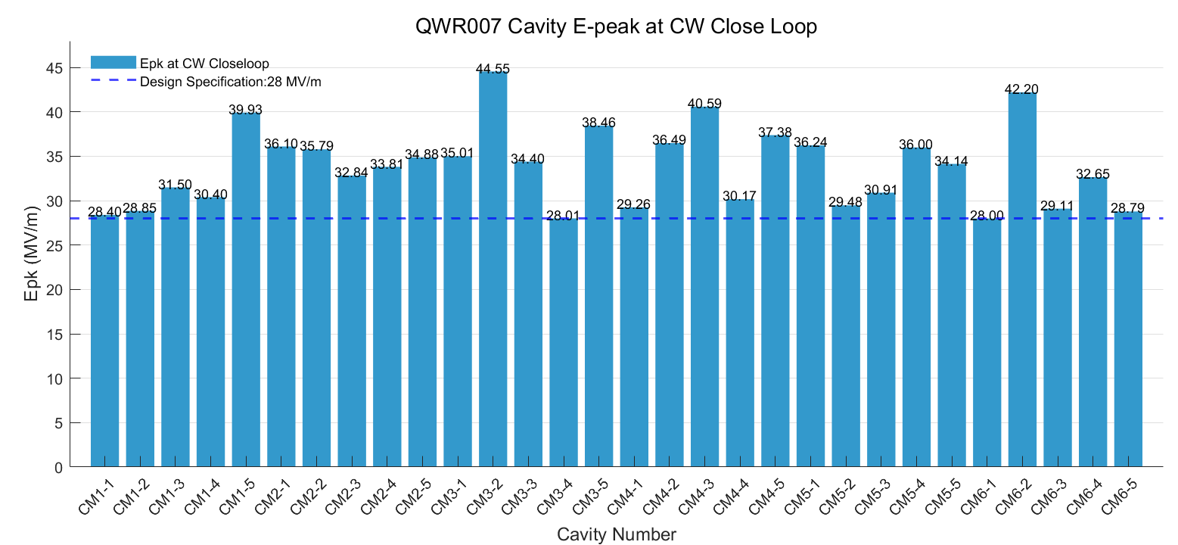
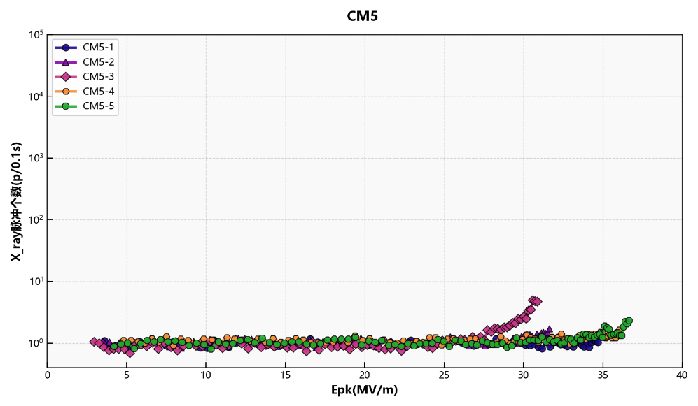
Peak gradient
The average E_{peak}​ in closed-loop operation is ~33 MV/m, exceeding the design value of 28 MV/m
Most cavities show field-emission onset above 20 MV/m
10⁴
CM4
10²
Radiation Dose [μSv]
10⁰
Peak gradient [MV/m]
10⁴
CM5
10²
Radiation Dose [μSv]
10⁰
Peak gradient [MV/m]

Slide 15
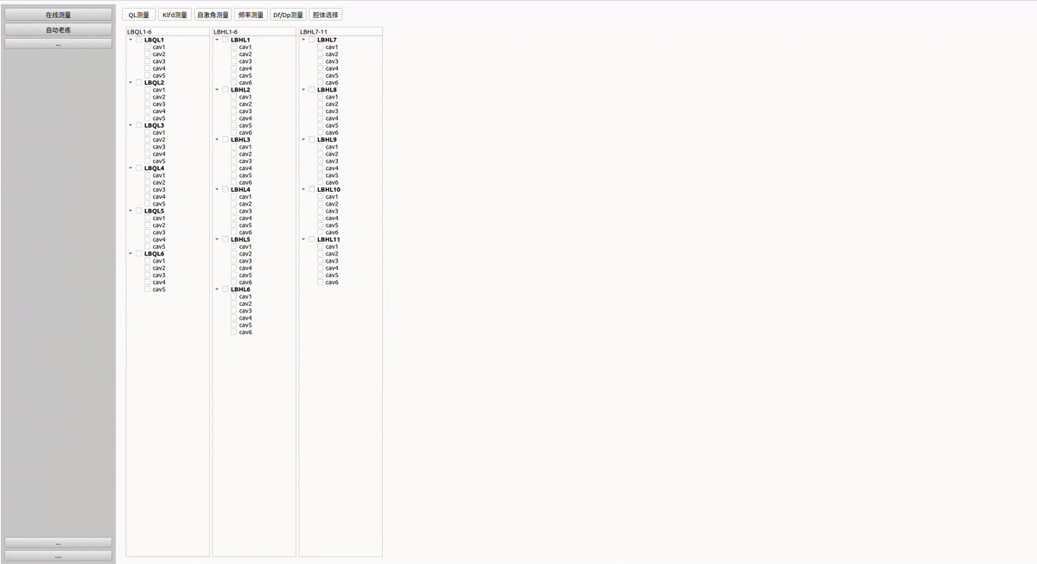
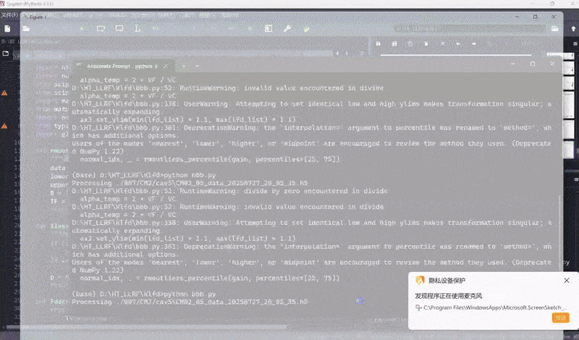
Measurement Automation
Automated batch measurements of cavity parameters: $Q_{L}$,(decay-based, rise-based and frequency scan) static LFD coefficient (K_{LFD}), and pressure sensitivity (df/fp)
Cavity Loaded Q
Static LFD Coefficient

Slide 16

01
Introduction
02
RF Parameter Characterization
CONTENTS
03
Automation, Diagostic & Opt.
04
Summary

Slide 17
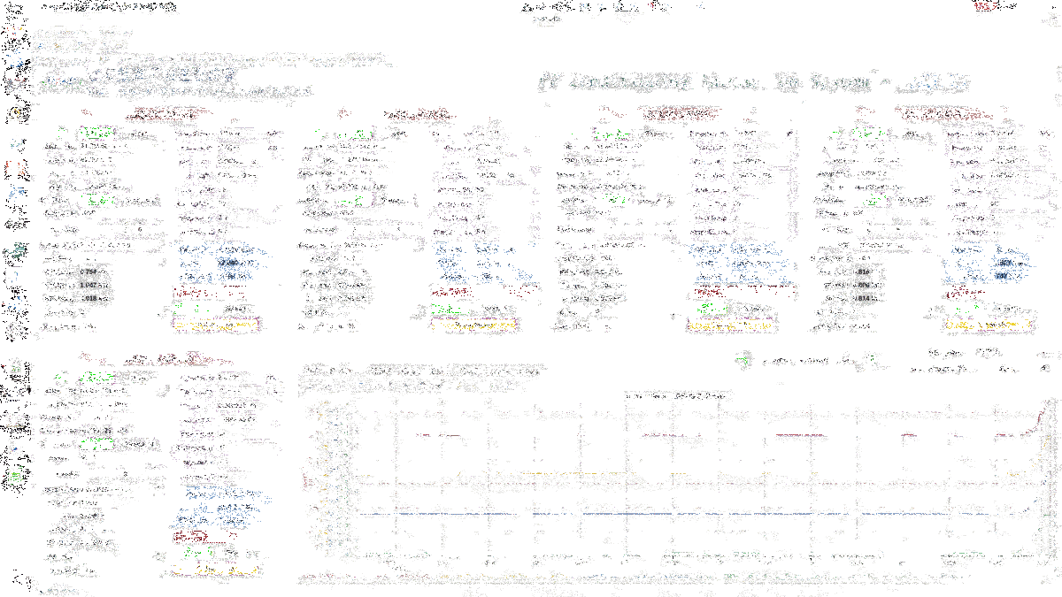
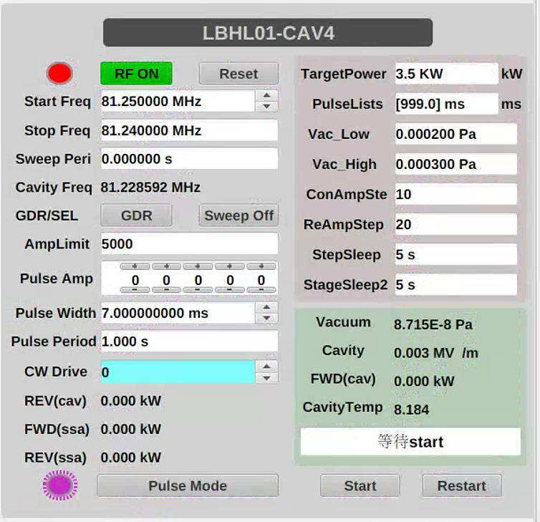

Automated RF Conditioning
Automated RF conditioning enables adaptive power ramp-up with real-time interlock and vacuum protection, achieving safe, efficient, and unattended cavity processing.
Key steps: initialization → power ramp-up → interlock/vacuum control → auto recovery → data logging.

Slide 18

Automated RF Loading
The RF control system automatically loads and initializes all superconducting cavities in pulse mode.
Each cryomodule is sequentially powered and monitored through the automated startup interface.

Slide 19







ML-based Abnomal Recognition
Features are extracted from RF conditioning data.
Machine learning automatically identifies abnormal events — feed-line faults and multipacting.
Multipacting
Expert experience-based Feature-Extraction
Flatroof
Feedline mismatch
Sawtooth type
Sawtooth type
Sawtooth type
Flatroof
Normal

Slide 20



Bayesian Opt. for Pulsed RF Ctrl.
Bayesian optimization is used to tune six coupled parameters in pulsed SRF operation, including PI gains (A/P loop), feed-forward amplitude (Fₐ), and feedback activation time (T_{FB}).
This approach minimizes RMS fluctuations at loop closure and enhances amplitude–phase stability during the beam flat-top.
Metrics:

Slide 21


RF stabilities
Bayesian optimization significantly improves both intra-pulse and pulse-to-pulse RF stability
Amplitude and phase stabilities during the flat-top are reduced to 0.02 % and 0.02 deg, while long-term pulse-to-pulse stability remian below 0.001 % and 0.003 deg
Before Opt.
After Opt.
Pulse-to-Pulse
0.02%
0.02 deg
Notes:
%

Slide 22
01
Introduction
02
RF Parameter Characterization
CONTENTS
03
Automation, Diagostic & Opt.
04
Summary

Slide 23
Summary
An integrated LLRF automation framework was developed, enabling automatic measurement of key cavity parameters — loaded Q, Lorentz-force detuning coefficient, and pressure sensitivity
Real-time batch operation was achieved for automated RF conditioning and pulse-mode loading across multiple superconducting cavities
Machine-learning-based intelligent diagnosis automatically identifies abnormal RF conditioning events, such as multipacting and feedline mismatches
Bayesian optimization of loop parameters in pulsed operation improves amplitude and phase stability by nearly one order of magnitude

Slide 24
Thanks for your attention

Slide 25
Back-up Slides

